Slide 1
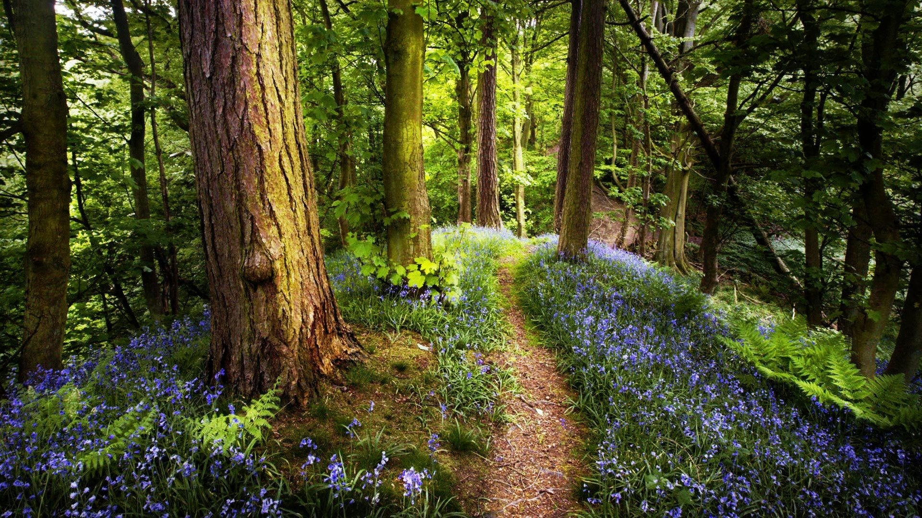
Welcome to Orwell Bible Church
The Lord’s Day April 21st, 2024

Slide 2
Service will Begin Shortly

Slide 3
Welcome! and Announcements

Slide 4
Call to Worship

Slide 5
Please stand and join us in praise and worship
“Jesus Shall Reign”

Slide 6
Verse 1 Jesus shall reign where'er the sun
Does its successive journeys run;
His kingdom stretch from shore to shore,
Till sun shall rise and set no more.

Slide 7
Verse 2 Blessings abound where'er He reigns;
The pris'ner leaps to lose his chains;
The weary find eternal rest,
And all the sons of want are blessed.

Slide 8
refrain:
To our King be highest praise
Rising through eternal days.
Just and faithful--He shall reign:
Jesus shall reign!

Slide 9
Verse 3
People and realms of every tongue
Dwell on His love
with sweetest song;
And infant voices shall proclaim
their early blessings on His Name.

Slide 10
refrain:
To our King be highest praise
Rising through eternal days.
Just and faithful--He shall reign:
Jesus shall reign!

Slide 11
Verse 4 Let every creature rise and bring
Blessing and honor to our King;
Angels descend with songs again,
And earth repeat the loud "Amen!”

Slide 12
refrain: 2X
To our King be highest praise
Rising through eternal days.
Just and faithful--He shall reign:
Jesus shall reign!
***
words: Isaac Watts, Keith Getty, Kristyn Getty; music: John Hatton, Keith Getty, Kristyn Getty, Ed Cash
copyright 2017 Getty Music Publishing and Alletrop Music CCLI #1407228

Slide 13
Please continue to stand and worship
“Holy Holy Holy”
#85

Slide 14
Angels We Have Heard On High
Verse 1 Holy, Holy, Holy!
Lord God Almighty!
Early in the morning our song shall rise to Thee.

Slide 15
Angels We Have Heard On High
Verse 1 Holy, Holy, Holy! Merciful and mighty!
God in three persons, blessed Trinity!

Slide 16
Angels We Have Heard On High
Verse 2 Holy, Holy, Holy! All the saints adore Thee,
casting down their golden crowns around the glassy sea;

Slide 17
Angels We Have Heard On High
Verse 2 cherubim and seraphim falling down before Thee,
which wert and art and evermore shalt be.

Slide 18
Angels We Have Heard On High
Verse 3 Holy, Holy, Holy! though the darkness hide Thee,
though the eye of sinful man Thy glory may not see,

Slide 19
Angels We Have Heard On High
Verse 3 only Thou art holy; there is none beside Thee,
perfect in pow'r, in love, and purity.

Slide 20
Angels We Have Heard On High
Verse 4 Holy, Holy, Holy! Lord God Almighty!
All Thy works shall praise Thy name in earth and sky and sea.

Slide 21
Angels We Have Heard On High
Verse 4 Holy, Holy, Holy! Merciful and mighty!
God in three persons, blessed Trinity.
***
words: Reginald Heber, 1783-1826; music: John B Dykes, 1823-1876; CCLI #1407228

Slide 22
Please continue to stand and worship
“How Great Thou Art”
#28

Slide 23
Verse 1
O Lord my God,
when I in awesome wonder,
Consider all the worlds
Thy hands have made;

Slide 24
Verse 1
I see the stars,
I hear the rolling thunder,
Thy power throughout
the universe displayed.

Slide 25
Chorus 2X
Then sings my soul,
my Savior God, to Thee,
How great Thou art! How great Thou art!

Slide 26
Verse 2
When through the woods,
and forest glades I wander,
And hear the birds sing sweetly in the trees.

Slide 27
Verse 2
When I look down,
from lofty mountain grandeur
And hear the brook, and feel the gentle breeze.

Slide 28
Chorus 2X
Then sings my soul,
my Savior God, to Thee,
How great Thou art! How great Thou art!

Slide 29
Verse 3
And when I think, that God,
His Son not sparing;
Sent Him to die,
I scarce can take it in;

Slide 30
Verse 3
That on the cross, my burden gladly bearing,
He bled and died
to take away my sin.

Slide 31
Chorus 2X
Then sings my soul,
my Savior God, to Thee,
How great Thou art! How great Thou art!

Slide 32
Verse 4:
When Christ shall come,
with shout of acclamation,
And take me home, what joy shall fill my heart.

Slide 33
Verse 4:
Then I shall bow, in humble adoration,
And then proclaim,
"My God, how great Thou art!”

Slide 34
Chorus 2X
Then sings my soul,
my Savior God, to Thee,
How great Thou art! How great Thou art!
***
words: Stuart K. Hine, 1889-1989; music: Swedish Folk Melody adapted by Stuart K. Hine copyright: 1949 and 1953

Slide 35
Pastoral Prayer
and Offering

Slide 36
Pastoral Prayer
and Offering

Slide 37
Please stand and prepare to hear from God’s Word
“Come All Christians
Be Committed”
#397

Slide 38
Verse 1 Come, all Christians,
be committed To the service of the lord;

Slide 39
Verse 1 Make your lives for him
more fitted, Tune your hearts with
one accord.

Slide 40
Verse 1 Come into His courts
with gladness, Each his sacred vows renew,

Slide 41
Verse 1 Turn away from sin
and sadness, Be transformed with life anew.

Slide 42
Verse 2 Of your time and talents
give now, They are gifts
from God above;

Slide 43
Verse 2 To be used by
Christians freely To proclaim
His wondrous love.

Slide 44
Verse 2 Come again to
serve the Savior, Tithes and off'rings
with you bring.

Slide 45
Verse 2 In your work,
with Christ find favor, And with joy His praises sing.

Slide 46
Verse 3 Come in praise and adoration, All who in Christ's name believe;

Slide 47
Verse 3 Worship Him with consecration, Grace and love
will you receive.

Slide 48
Verse 3 For His grace
give Christ the glory, For the Spirit and the Word,

Slide 49
Verse 3 And repeat the gospel story Until all His name have heard.
***
Words: Eva B. Lloyd, 1912-Music: B. F. White, 1800-1879; Broadman Press 1968; CCLI #1407228

Slide 50
Kidz Church
Kids Church is Dismissed,
Nursery Dismissed

Slide 51
Remember to turn on the Record!

Slide 52
Insert
Message Power Point Here

Slide 53
Prepare to encourage others in Baptism
“Wonderful Merciful Savior”
#263

Slide 54
Verse 1
Wonderful, merciful Savior
Precious Redeemer and Friend
Who would have thought that a Lamb
Could rescue the souls of men
Oh, You rescue the souls of men

Slide 55
chorus
You are the One that we praise,
You are the One we adore
You give the healing and grace our
Hearts always hunger for,
Oh, our hearts always hunger for.

Slide 56
Verse 2
Counselor, Comforter, Keeper
Spirit we long to embrace
You offer hope when our hearts have
Hopelessly lost our way
Oh, we've hopelessly lost the way

Slide 57
chorus
You are the One that we praise,
You are the One we adore
You give the healing and grace our
Hearts always hunger for,
Oh, our hearts always hunger for.

Slide 58
Verse 3
Almighty, infinite Father
Faithfully loving Your own
Here in our weakness You find us
Falling before Your throne
Oh, we're falling before Your throne

Slide 59
chorus
You are the One that we praise,
You are the One we adore
You give the healing and grace our
Hearts always hunger for,
Oh, our hearts always hunger for.
***
Words and Music by Dawn Rodgers 1957 copyright 1989 Word Music

Slide 60
Baptism
Service

Slide 61
Prepare your hearts to Serve God this week
“Jesus Paid It All”
#276

Slide 62
Verse 1 I hear the Savior say, "Thy strength indeed is small, Child of weakness,
watch and pray, Find in Me thine all in all."

Slide 63
Refrain: Jesus paid it all, All to Him I owe; Sin had left a crimson stain, He washed it white as snow.

Slide 64
Verse 2 Lord, now indeed I find Thy pow'r and Thine alone, Can change the leper's spots And melt the heart of stone.

Slide 65
Refrain: Jesus paid it all, All to Him I owe; Sin had left a crimson stain, He washed it white as snow.

Slide 66
Verse 3 For nothing good have I Where-by Thy grace to claim; I'll wash my garments white In the blood of Calv'ry's Lamb.

Slide 67
Refrain: Jesus paid it all, All to Him I owe; Sin had left a crimson stain, He washed it white as snow.

Slide 68
Verse 4 And when, before the throne, I stand in Him complete, "Jesus died my soul to save," My lips shall still repeat.

Slide 69
Refrain: Jesus paid it all, All to Him I owe; Sin had left a crimson stain, He washed it white as snow.
***
words: Elvinia M. Hall, 1820-1889; music: John T. Grape, 1835-1915

Slide 70
Benediction
from
Pastor Glen

Slide 71
Thank You
for Coming
Don’t forget Wednesday Prayer Service @ 6:30

